Slide 1
Raw metagenomics reads
n = ##
MAG recovery
Final refinements
(i) QS = completeness − (5 × contamination)
Remove bins with QS < 50
(ii) High-quality MAGs
Completeness ≥90%
Contamination ≤5%
(iii) Medium-quality MAGs
Completeness >50%
Contamination ≤10%
Metagenomics samples
Quality control
BBduk
Binning
Contigs ≥ 1 kb are binned:
-BinSanity: Min scaffold: 3 kb
-ABAWACA: Min scaffold: 5 kb
-MaxBin2: 40 & 107 gene marker
-CONCOCT
-MetaBAT2
Metagenomics processing
MAGs generation
Assembly
metaSPAdes, MEGAHIT
Quallity check
CheckM
Filtering 1
(i) VirSorter2
Filtering 1
(ii) Vibrant
default
Filtering 1
(iii) DeepVirFinder
Score ≥ 0.9, e-value ≤ 0.05
Filtering 1
(iv) GeNomad
default
Binning refinement
MetaWRAP: filters -c 50 -x 10
Dereplication: dRep
Taxonomy
GTDBtk
Identified contigs
##
Read mapping
(minimap2 + SAMtools + CoverM)
vOTU
table
Viral identification
Filtering 2
i) Virus genes >0,
ii) virus gene =0 and host gene = 0,
iii) Those with unknown genes ≥ 75%
iv) Trim host region with CheckV
Ecological analysis
α, β Diversity
Shared, unique core, common, rare assesment
Microdiversity analysis
Identified contigs
##
Taxonomy
vConTACT3 default
geNomad
Taxonomy
Filtering 3
Curation filter to vOTUs ≥100 kb
Remove putative
genomic islands/mobile elements
Exclude contigs with:
- transposons
- LPS genes
- integrases
- endonucleases
- plasmid stability genes
vOTU clustering
MMseq2
(≥95% ID across ≥80% length)
Host prediction
(i) iPHoP
- default DB
- local MAGs
(ii) CRISPR spacer matching
- MinCED
- BLASTn
vOTU
## (<1 kb)
## (≥5 kb)
## (≥10 kb)
Host
Viral operational taxonomic units (vOTUS)
vOTU
## (<1 kb)
## (≥5 kb)
## (≥10 kb)
AMG prediction
-DRAMv & DRAM (MAGs)
-KEGG mapper
Functionality
Quality & completeness
assessment
CheckV
Lifestyle prediction
(lytic vs temperate)
VIBRANT
Notes:
Fig.1. Bioinformatics workflow

Slide 2
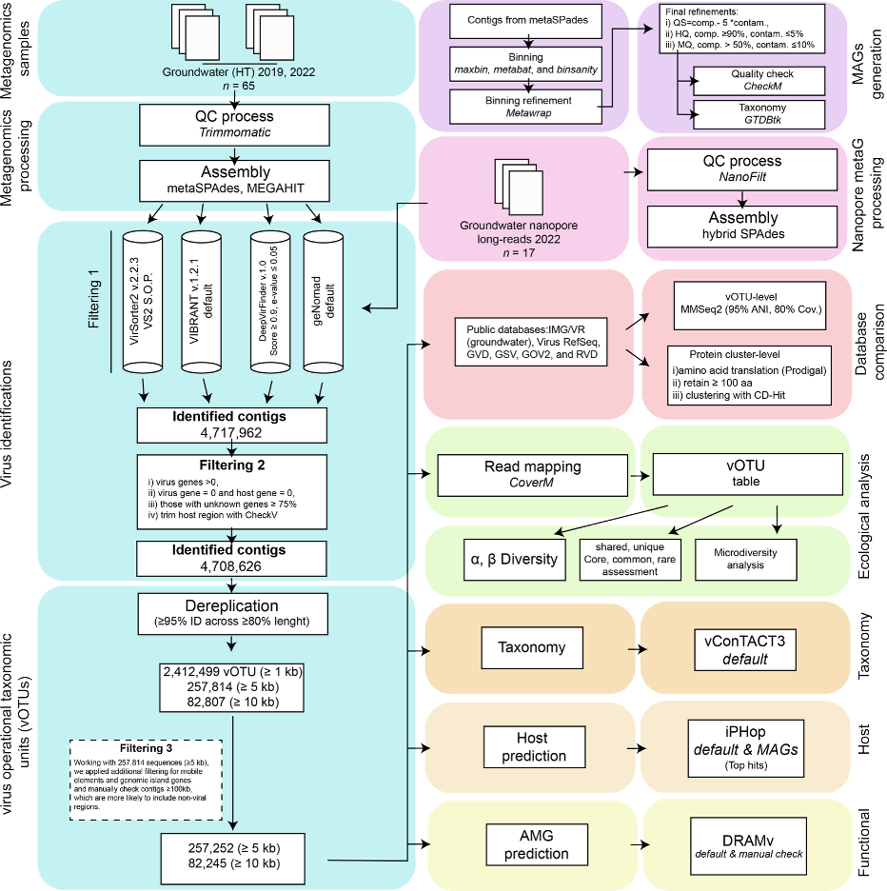
https://www.nature.com/articles/s41467-026-68914-2#Sec10

